Slide 1
Python Language

Slide 2
Content
Introduction
IDLE
Data types
Mathematical operators
Input /Output
Strings
Range() function
Control structure
Iteration
For loop and while loop

Slide 3
Introduction to Python
Python is a powerful modern computer programming language.
Python allows you to use variables without declaring them (i.e., it determines types implicitly), and it relies on indentation as a control structure.
Python was developed by Guido van Rossum, and it is free software.
The object-oriented nature of Python was part of its design from the very beginning.
Python is available on a wide variety of platforms.

Slide 4
Introduction to Python (Cont)
Python has relatively few keywords, simple structure, and a clearly defined syntax. This allows the student to pick up the language in a relatively short period of time.
You can download the latest version by visiting the Python home page, at http://www.python.org.
Python has an interpreter.
Unlike human languages, the Python vocabulary is actually pretty small.
The biggest pitfall with programming in C or C++ is that the responsibility of memory management is in the hands of the developer. The memory management is performed by the Python interpreter.

Slide 5
IDLE
An IDE is an integrated development environment—one program that provides all the tools that developer needs to write software.
To exit the Python interactive prompt, we need to use an end-of-file character. Under Windows, this corresponds to the Ctrl-Z key combination; in Linux, it corresponds to Ctrl-D.
Alternatively, one can use the exit() function:

Slide 6
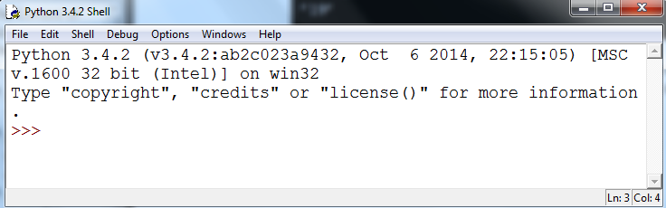
IDLE (Cont)

Slide 7
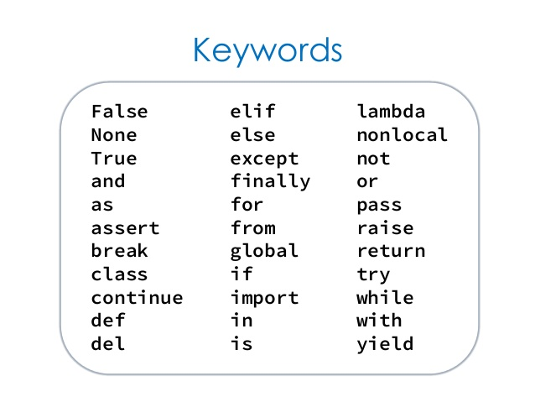
Reserved words

Slide 8
Variables
A variable can be any combination of letters, digits and underscore characters.
The first character cannot be a digit.
Variables in Python are case sensitive: variable and VARIABLE are not the same.
Reserved word cannot be used for the variables.
It should be a meaningful name. WWW.64BITS.LK
Spacing is not allowed for the variables.
Example : X _LabName RESULT2 VaRiAbLe

Slide 9
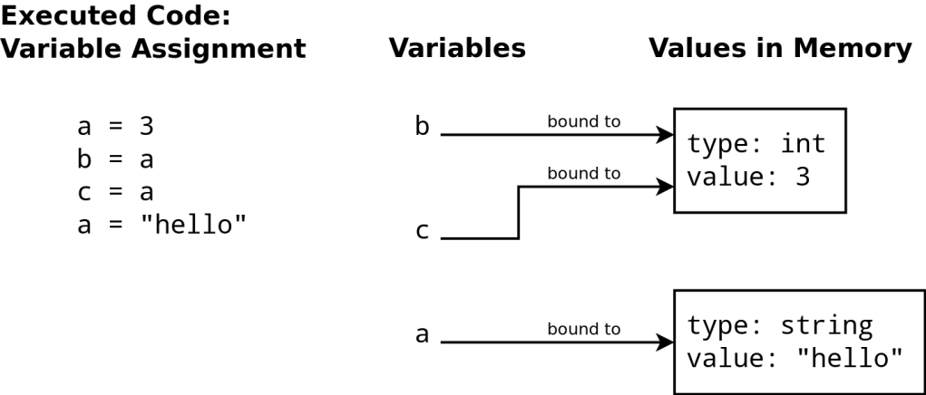
Variables (Cont)

Slide 10
Variables (Cont)
Assigning Values to Variables:
Python variables do not have to be explicitly declared to reserve memory space. The declaration happens automatically when you assign a value to a variable.
The equal sign (=) is used to assign values to variables.

Slide 11


Variables (Cont)

Slide 12
Built in types of Data
A data type is a set of values and a set of operations defined on those values. Many data types are built into the Python language.
In this section, we consider Python's built-in data types int (for integers), float (for floating-point numbers), str (for sequences of characters) and bool (for true-false values).

Slide 13
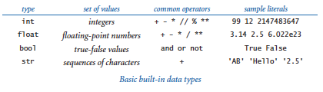
Built in types of Data (Cont)

Slide 14
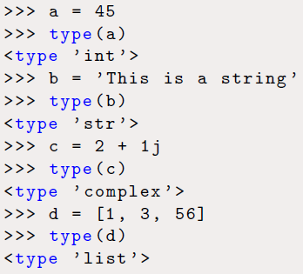
type() function

Slide 15
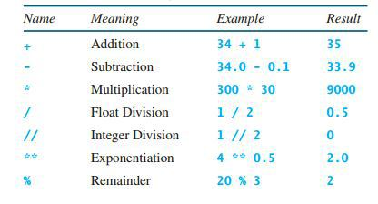
Mathematics Operators

Slide 16
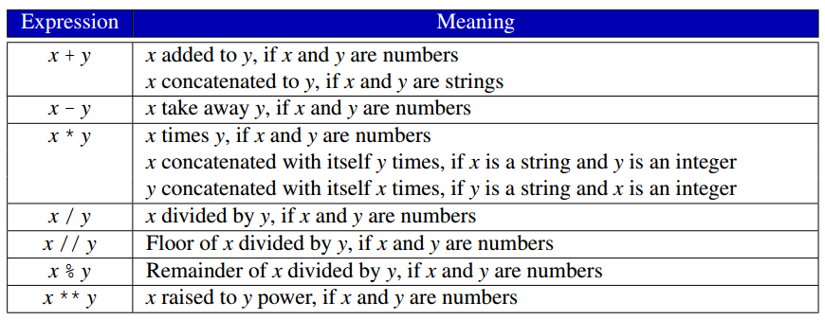
Mathematics Operators (Cont)

Slide 17
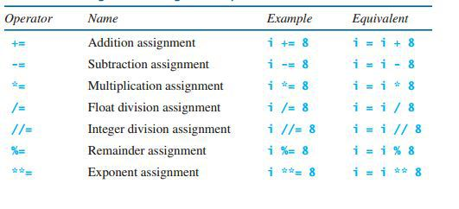
Mathematics Operators (Cont)

Slide 18
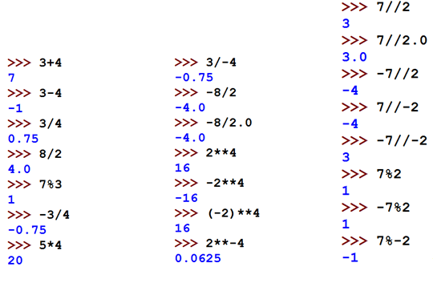
Type the commands and get the output

Slide 19
Type the following commands and explain the output
-20// 3
-20%3

Slide 20
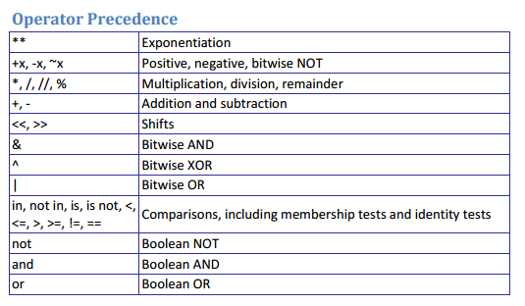
Operator Precedence

Slide 21
Print() function
A program consists of one or more statements. A statement is an instruction that the interpreter executes.
The following statement invokes the print function to display a message:
print("This is a simple Python program")
By default, the print function places a single space in between the items it prints. Print uses a keyword argument named sep to specify the string to use insert between items. The name sep stands for separator.

Slide 22
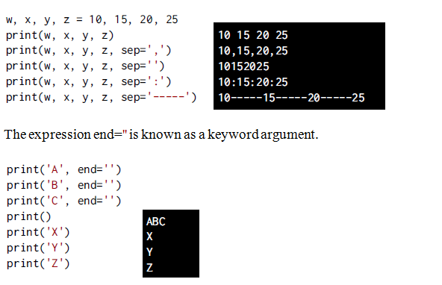
Print() function (Cont)

Slide 23
Comments
In a Python command, anything after a # symbol is a comment.
Comments are not part of the command, but rather intended as documentation for anyone reading the code. Multiline comments are also possible, and are enclosed by triple double-quote symbols:
For example:
print( " Hello world ") # this is a comment

Slide 24
input() function
The built-in function input() takes a string argument. This string is used as a prompt. When the input() function is called, the prompt is printed and the program waits for the user to provide input via the keyboard.
input(): Prompts the user for input with its string argument and returns the string the user enters.

Slide 25
Find the difference between the outputs:
a=input(‘Enter a number:’)
print(a)
a=int(input(‘Enter a number:’))
print(a)
a=float(input(‘Enter a number:’))
print(a)

Slide 26
Built-in Functions
int(): Returns the integer form of its argument.
float(): Returns the float form of its argument.
str(): Returns the string of its argument.
Bool(): Returns the Boolean value True or False
chr(): Returns the character for the ASCII value
ord(): Returns the ASCII value
eval(): Returns the result of evaluating its string argument as any Python expression, including arithmetic and numerical expressions

Slide 27
Exercise
Write a program to read character and get the corresponding ASCII value for the character entered.
Write a program to read a number and get the corresponding character from the ASCII table.
Note: Open a new file in file menu and save the file with the extension of .py

Slide 28
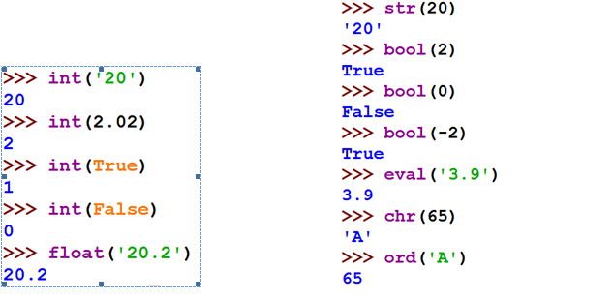
Built-in Functions (Cont)

Slide 29
Strings
A string is created by enclosing text in quotes. You can use either single quotes, ', or double quotes, ". A triple-quote can be used for multi-line strings.
To get the length of a string (how many characters it has), use the built-in function len. For example, len('Hello') is 5

Slide 30
Strings Concatenation and repetition
The operators + and * can be used on strings.
The + operator combines two strings. This operation is called concatenation.
The * repeats a string a certain number of times.

Slide 31
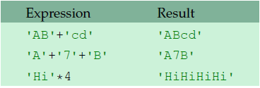
Strings Concatenation and repetition (Cont)

Slide 32
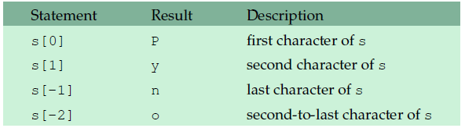
Indexing
We will often want to pick out individual characters from a string.
Python uses square brackets to do this.
The table below gives some examples of indexing the string
s='Python'

Slide 33
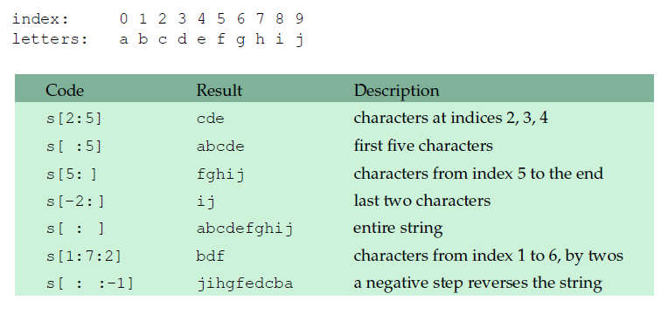
Slices
A slice is used to pick out part of a string. It behaves like a combination of indexing and the range function.
Below we have some examples with the string
s='abcdefghij'.

Slide 34
Write the code and get the outputs?
S=‘ABCDEFGHIJKL’
S[2:6]
S[:8]
S[3:]
S[2:9:2]
S[-3:]
S[:]
S[::-1]
len(S)

Slide 35
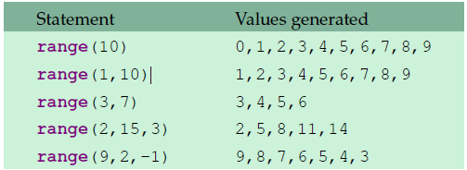
The range function

Slide 36
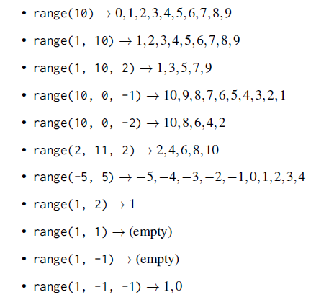
The range function (Cont)

Slide 37
Execute the following codes:
for i in range(10):
print(i)
for i in range(10):
print(i, end=‘ ’)
for i in range(3,9):
print(i)

Slide 38
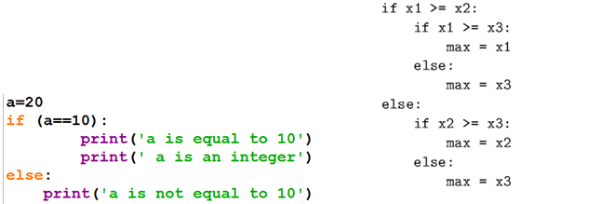
Conditional Statement

Slide 39
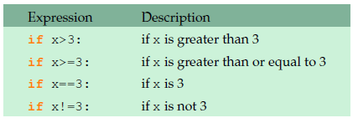
Comparison Operators
The comparison operators are ==, >, <, >=, <=, and !=
That last one is for not equals.
Here are a few examples

Slide 40
Exercise
Write a python program to read the two numbers and find the largest number.
Write a python program to read the three numbers and find the minimum number.
Write a python program to read a number and display the number as odd or even.

Slide 41
Iteration (Loops)
Computers are often used to automate repetitive tasks.
For loops
Probably the most powerful thing about computers is that they can repeat things over and over very quickly.

Slide 42
Iteration and Loops
A loop repeats a sequence of statements
A definite loop repeats a sequence of statements a predictable number of times
Count n
times
for count in range(5): print('Hello!')
Hello
Hello
Hello
Hello
Hello
Statements

Slide 43
The for Loop
Python’s for loop can be used to iterate a definite number of times
for <variable> in range(<number of times>): <statement>
Use this syntax when you have only one statement to repeat
Count n
times
for count in range(5): print('Hello!')
Hello
Hello
Hello
Hello
Hello
Statements

Slide 44
The for Loop
for <variable> in range(<number of times>):
<statement-1>
<statement-2>
…
<statement-n>
loop header
loop body
Use indentation to format two or more statements below the loop header
for count in range(3):
print('Hello!')
print('goodbye')
Count n
times
Hello!
goodbye
Hello!
goodbye
Hello!
goodbye
Statements

Slide 45
Using the Loop Variable
The loop variable picks up the next value in a sequence on each pass through the loop
The expression range(n) generates a sequence of ints from 0 through n - 1
loop variable
>>> for count in range(5): print(count)
...
0
1
2
3
4
>>> list(range(5)) # Show as a list
[0, 1, 2, 3, 4]
Count n
times
Statements

Slide 46
Counting from 1 through n
The expression range(low, high) generates a sequence of ints from low through high - 1
>>> for count in range(1, 6): print(count)
...
1
2
3
4
5
>>> list(range(1, 6)) # Show as a list
[1, 2, 3, 4, 5]
Count h - l
times
Statements

Slide 47
Skipping Steps in a Sequence
The expression range(low, high, step) generates a sequence of ints starting with low and counting by step until high - 1 is reached or exceeded
Count (h - l + 1)
times
>>> for count in range(1, 6, 2):
print(count)
...
1
3
5
>>> list(range(1, 6, 2)) # Show as a list
[1, 3, 5]
Statements

Slide 48
Counting down in a Sequence
The expression range(high, low, step) generates a sequence of ints starting with high and counting by step until low - 1 is reached, when step is negative
Count (h - l + 1)
times
>>> for count in range(4, 1, -1):
print(count)
...
4
3
2
>>> list(range(4, 1, -1)) # Show as a list
[4, 3, 2]
Statements

Slide 49
Accumulator Loop: Summation
Compute and print the sum of the numbers between 1 and 5, inclusive
total = 0
for n in range(1, 6):
total = total + n
print(total)
In this program, the variable total is called an accumulator variable

Slide 50

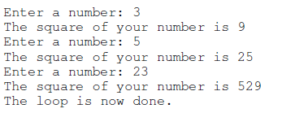
Iteration (Cont)
Output

Slide 51
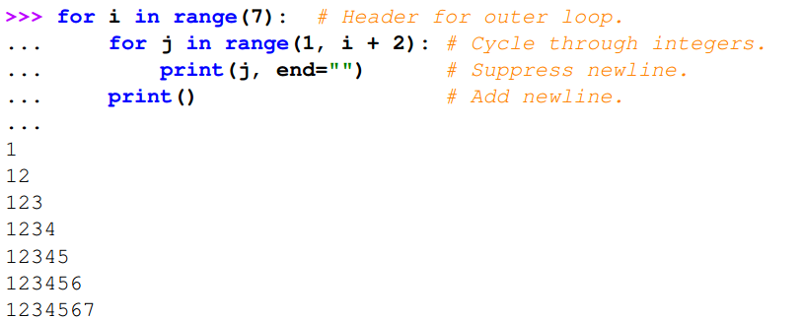
Iteration (Cont)
Output

Slide 52
Iteration (Cont)
While Loop
while (conditional test):
Statement 01
Statement 02
…………………..
Statement n
While something is True keep running the loop, exit as soon as the test is False.
The conditional test syntax is the same as for if and elif statements.

Slide 53

Iteration (Cont)

Slide 54

The break statement
The break statement can be used to break out of a for or while loop before the loop is finished

Slide 55

The Continue statement
This is a control flow statement that causes the program to immediately skip the processing of the rest of the body of the loop, for the current iteration.
But the loop still carries on running for its remaining iterations:

Slide 56
The pass Statement
The pass statement in Python is used when a statement is required syntactically but you do not want any command or code to execute.

Slide 57
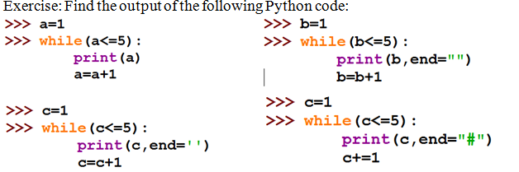
Exercise

Slide 58
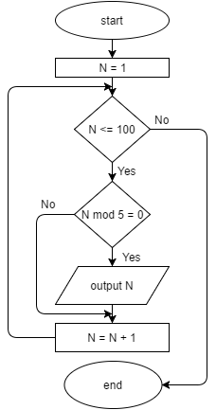
Implement the following flowchart in Python and get the output.

Slide 59
Questions??

Slide 60
Thank you!!

